Slide 1
Community Contribution Tutorial: Insightful Explorer PRESENTED BY : RIDDHI DINESH OZA (RO2418) & RAMON CUITAD (RC3714)

Slide 2
Project Overview
Interactive app, Insightful Explorer, to generate and visualize synthetic data.
Built using R’s shiny, shinydashboard and synthpop packages.
Customizable patient metrics, dynamic data visualization, and filtering options.

Slide 3
Steps to Develop Insightful Explorer

Slide 4
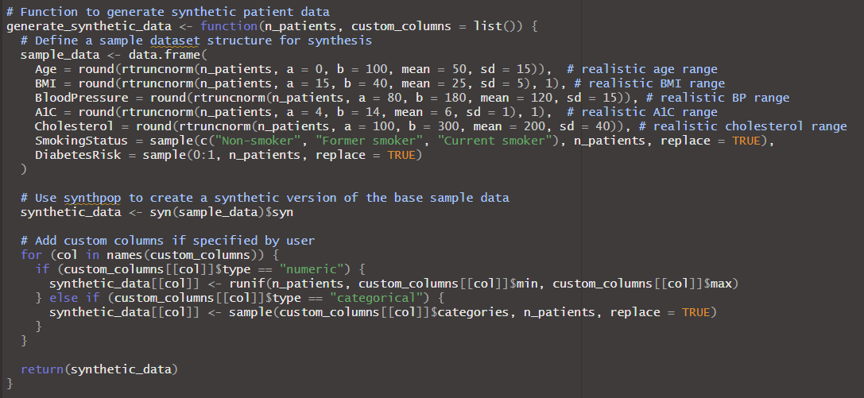
Step 1: Data Generation with Synthetic Columns

Slide 5
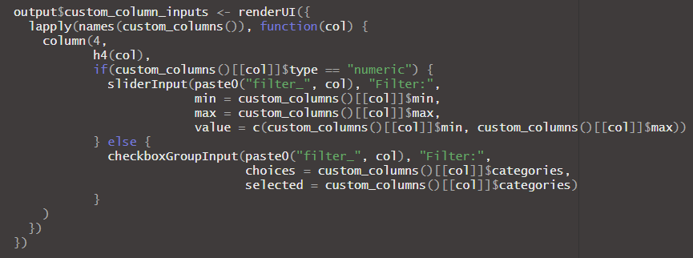
Step 2: Data Exploration

Slide 6
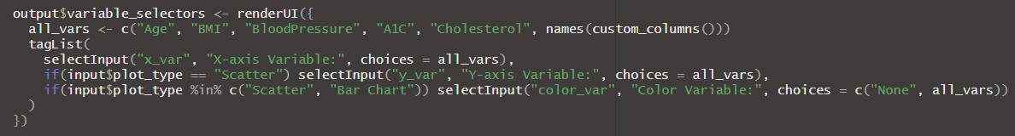
Step 3: Data Visualization Options

Slide 7
Let’s Walk Through Insightful Explorer

Slide 8
Benefits to the Community
Safe, accessible way to practice healthcare data analysis with synthetic data.
Enables data exploration without using real patient data, ensuring privacy.
Helps users understand data-driven insights, benefiting healthcare studies and practice.

Slide 9
Thank you

